Slide 1
CSE322
ALGEBRIC METHODS USING ARDEN’S THEORM
Lecture #8

Slide 2
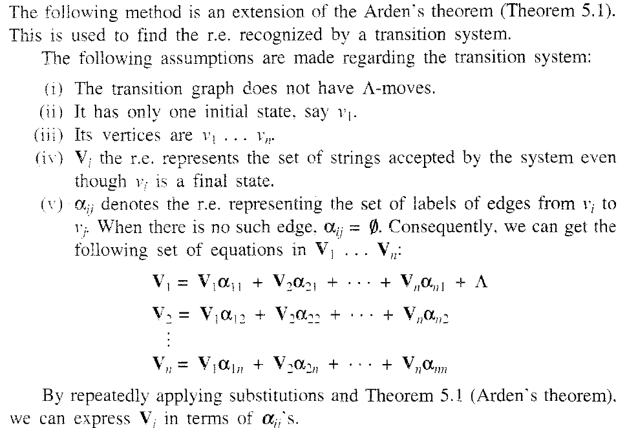
ALGEBRIC METHOD ISUNG ARDEN’S THEORM

Slide 3
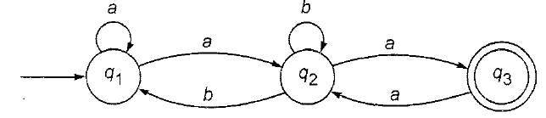
ALGEBRIC METHOD ISUNG ARDEN’S THEORM

Slide 4
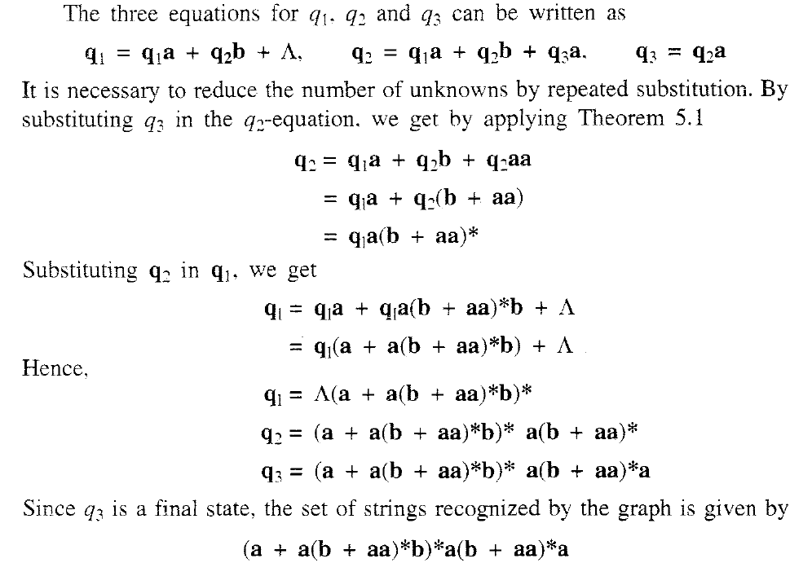
ALGEBRIC METHOD ISUNG ARDEN’S THEORM

